Slide 1

Professional Development Career Conversations for 2025
Are you studying in 2025?
Anjana Naidu
Nurse Director Workforce Development
Capital, Coast & Hutt Valley District
Notes:
Kia ora
Ko Anjana Naidu tōku igoa. I am the Nurse Director Workforce Development for the Capital, Coast and Hutt Valley District.
New Zealand has a high-quality publicly funded health system which is supported by a highly skilled, dedicated and professional health workforce.
Capital, Coast and Hutt Valley District manages funding on behalf of Te Whatu Ora to support nurses engaged in postgraduate study. Postgraduate (PG) funding enables the development of a skilled and knowledgeable workforce that supports the services to deliver safe healthcare.
Postgraduate funding was formerly known as Health Workforce funding.
Career conversations and funding applications for the 2025 academic year started on the 1st July and postgraduate funding applications open on the 1 August.
This information tells you why we take this approach and how to participate. The academic year is inclusive of three trimesters, so if you are studying in trimesters one, two or three in 2025, this application information is for you.

Slide 2
Government Policy Statement on Health 2024–2027
Access – ensuring all New Zealanders have equitable access to the health care services they need, no matter where they live.
Timeliness – making sure all New Zealanders can access these services in a prompt and efficient way.
Quality – ensuring New Zealand’s health care and services are safe, easy to navigate, understandable and welcoming to users, and are continuously improving.
Workforce – having a skilled and culturally capable workforce who are accessible, responsive, and supported to deliver safe and effective health care.
Infrastructure – ensuring that the health system is resilient and has the digital and physical infrastructure it needs to meet people’s needs now and the future.
Notes:
The Government policy statement for 2024-2027 is informed by New Zealand Health Strategy and Pae Ora. The Government policy statement includes 5 priorities and includes workforce. The Workforce priority focuses on growing the workforce that has the skills and is culturally capable to deliver safe and efficient healthcare.
Through the passing of the Pae Ora (Healthy Futures) Act in 2022, the government created the necessary foundations for transformation of the health system.
The aim of the health system is to create a more equitable, accessible, cohesive and people-centred system that will improve the health and wellbeing of all New Zealanders.
The national health system has been designed to enable a whole-of-country view to planning and delivering services, helping it to be efficient and consistent everywhere. It also means that when it comes to health services, where you live will matter less than what you need, so everyone gets the right healthcare, where and when they need it.
Government policy statement ties in with the Health targets which were announced in February 2025.

Slide 3
Health Targets
Faster cancer treatment
Improved childhood immunisation
Shorter stays in emergency departments
Shorter wait times for first specialist assessments and
Shorter wait times for elective treatment.
Notes:
The Government has announced health targets that will support the delivery of better health outcomes for New Zealanders and improve the performance of our health services throughout the motu.
The health targets include Faster cancer treatment, Improved childhood immunisation, Shorter stays in emergency departments, Shorter wait times for first specialist assessments and Shorter wait times for elective treatment.
Performance of these health targets will be reported quarterly.
A skilled and educated workforce is needed in order to deliver the health targets.

Slide 4
Capital Coast and Hutt Valley
Workforce and Practice Development Unit
The Workforce and Practice Development Unit supports the Chief Nursing Officer (CNO), the Nurse Director, Director of Nursing and Director of Midwifery roles. The support enables the alignment of the CNO's professional, operational and strategic leadership accountability with the nursing and midwifery programmes to reflect national, regional and local priorities.
Professional development is an important workforce focus across Hospital and Specialist Services, Primary healthcare and Aged and Residential care settings.
Notes:
The Workforce and Practice Development Unit supports the Chief Nursing Officer, the Nurse Director, Director of Nursing and Director of Midwifery roles.
Professional development is an important workforce focus across Hospital and Specialist Services, the Primary healthcare, and Aged and Residential care settings.
Professional development ensures that the workforce has the skills and knowledge to provide quality patient care.

Slide 5
Postgraduate funding and Career conversations
Engage with tertiary education providers
Desired outcome documented in your Professional Development and Career plan – engage with you Managers and Nurse Educators in the clinical environment
Look at the whole qualification – is this the qualification I need? Know timelines and the core papers to complete the qualification
Study locally
Notes:
Career conversations are a well-established career development mechanism to promote professional development aligned with population health needs.
The Tertiary Education Providers have provided an outline of papers, courses and qualification pathways via videos. These are available on the Nursing website.
This is so you can be supported to develop your career and also to meet service needs to deliver care to meet population health needs.
Roadshows are organised across the District this year to showcase the courses and pathways available.

Slide 6

Notes:
This year the roadshows will be held across the District starting at Hutt Valley on the 1st August, then Kenepuru on the 8th of August and at Wellington on the 15th August.
This is a fantastic opportunity to meet the staff from the Tertiary Education sector to discuss the papers you may want to study in 2025. Please ensure that you discuss the core papers required for gaining your qualification.

Slide 7
Criteria for application
Current portfolio on the Professional Development and Recognition Programme (PDRP) at time of application
0.6 FTE and above
Contribution to your area
Supported to complete qualification if role requires it (PG Cert, Diploma, Masters)
Competent RNs may be funded to PG certificate level (2 papers) based on service specifications/role
Proficient RNs may be funded to PG certificate/diploma level (2 to 3 papers) based on service specifications/role
Expert RNs may be funded to PG diploma level (4 papers) based on service specifications/role
RN Expert on a service agreed Nurse Practitioner pathway may be funded to Masters level based on service specifications. This may include nurses who have previously completed Masters degree
Nurses in senior designated roles may be funded to Masters level
Nurse Educators may be funded to Masters level with a focus on education
Notes:
Post Graduate funding supports nurses to complete level 8 postgraduate qualifications.
There is insufficient funding to support all applicants, hence applications are prioritised based on criteria.
Prioritisation follows the initial application supported by line managers and Nurse Directors. All applicants need to have a current PDRP portfolio at time of application and work 0.6 FTE or above and choose papers which enable them to deliver to service outcomes for their role.
Criteria for funding are outlined on the website.
Competent RNs may be funded to PG certificate level (2 papers) based on service specifications/role
Proficient RNs may be funded to PG certificate/diploma level (2 to 3 papers) based on service specifications/role
Expert RNs may be funded to PG diploma level (4 papers) based on service specifications/role
The prioritised papers include Pathophysiology/anatomy and physiology, Advanced assessment, Pharmacology for nurses on the clinical pathway. Other papers may be funded where directly relevant to the nurses role or strategic goals e.g. Māori health & wellbeing.
RN Expert on a service agreed Nurse Practitioner pathway may be funded to Masters level based on service specifications. This may include nurses who have previously completed Masters degree
Nurses in senior designated roles may be funded to Masters level
Nurse Educators may be funded to Masters level with a focus on education
All applications are web-based.
Please check the website for further details.

Slide 8
What is funded?
Tuition Fees – paid directly to TEP
Travel – partial funding for papers not taught locally
Accommodation – actual costs up to $200 per night
Clinical supervision or clinical release
Supervision as per support plan for RN Prescriber and Nurse Practitioner Practicum
Notes:
Tuition Fees are paid directly to TEP
For those who are travelling to complete their papers, partial funding will be provided.
Accommodation –actual costs up to $200 per night
For papers that need Clinical supervision like RN Prescriber and Nurse Practitioner Practicum, a support plan is required
Local courses are prioritised to minimise travel costs

Slide 9
You will need the following to apply:
Academic transcript of PG papers previously completed
Number of block course days required for your paper(s)
Date of your last Performance Review
Date you last progressed/maintained your PDRP Portfolio
Work FTE (e.g. 1.0 FTE = 40hrs per week)
Completed Professional Development and Career plan (PDCP)

Slide 10
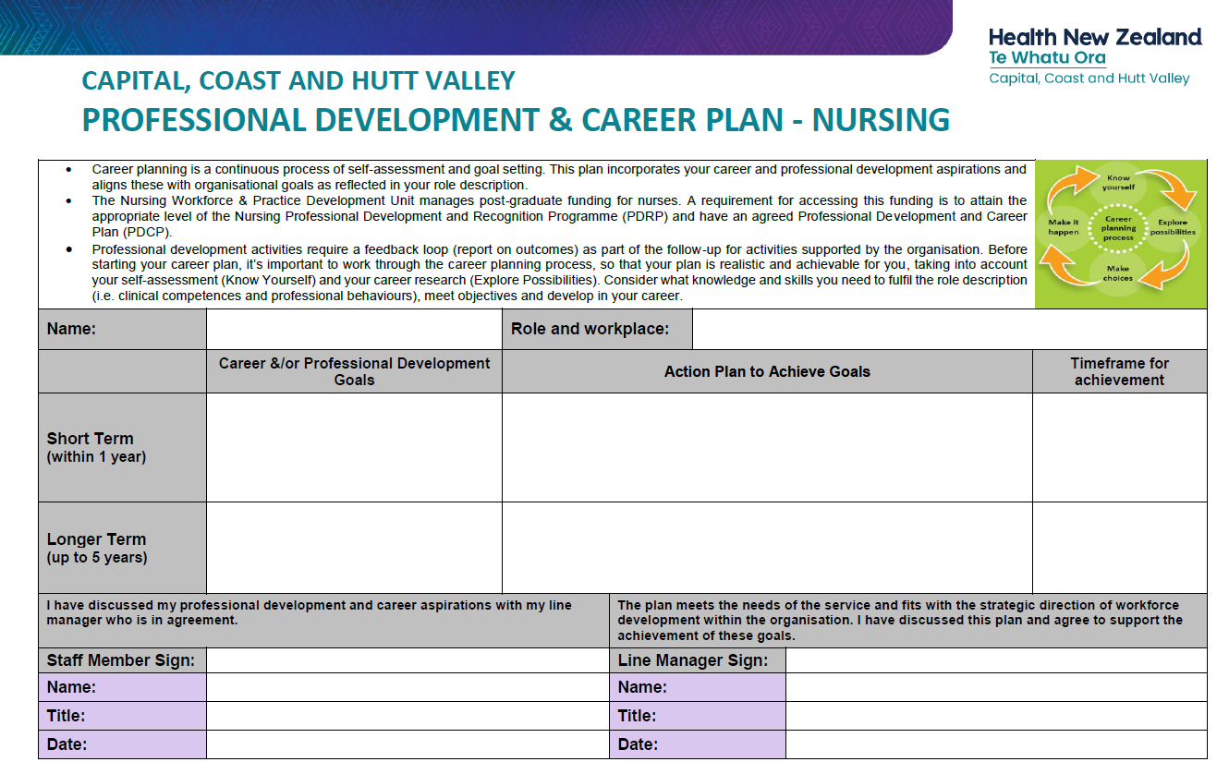
Notes:
Please complete your professional development and career plan with your manager if you have not done so already and ensure this is signed and dated.

Slide 11
Applications open 1 August 2024
Apply – online application
Application acknowledged when received
Your Nurse Director and CNM/TL prioritise applications
NAML prioritisation occurs
Apply to Tertiary Education Provider
Approval email sent to applicant in early December
Study begins
Applications close: 4th October 2024

Slide 12
Nga mihi Aroha
Notes:
All the best for your studies in 2025.

